Slide 1


Lean 6 Sigma Toolkit
Overview

Slide 2
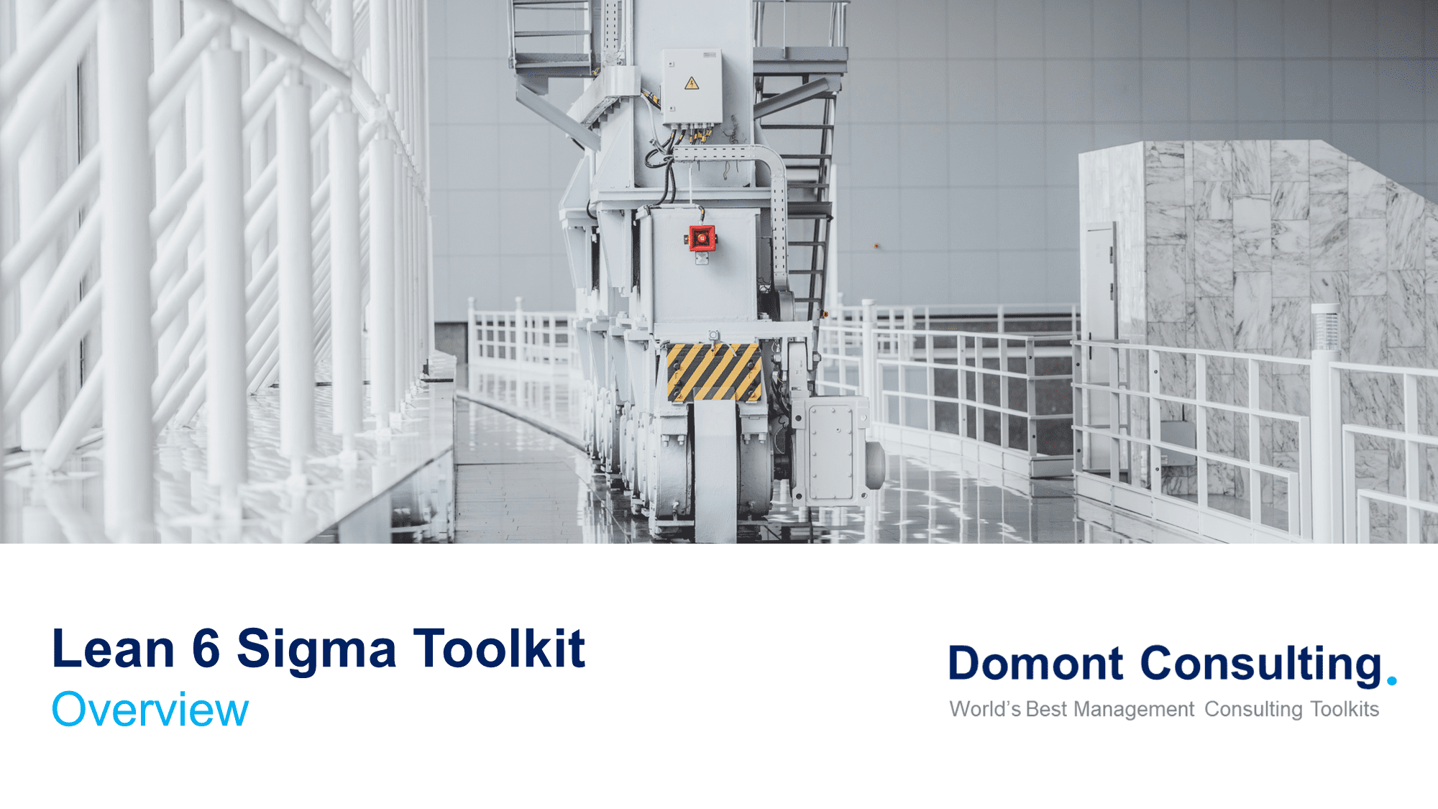
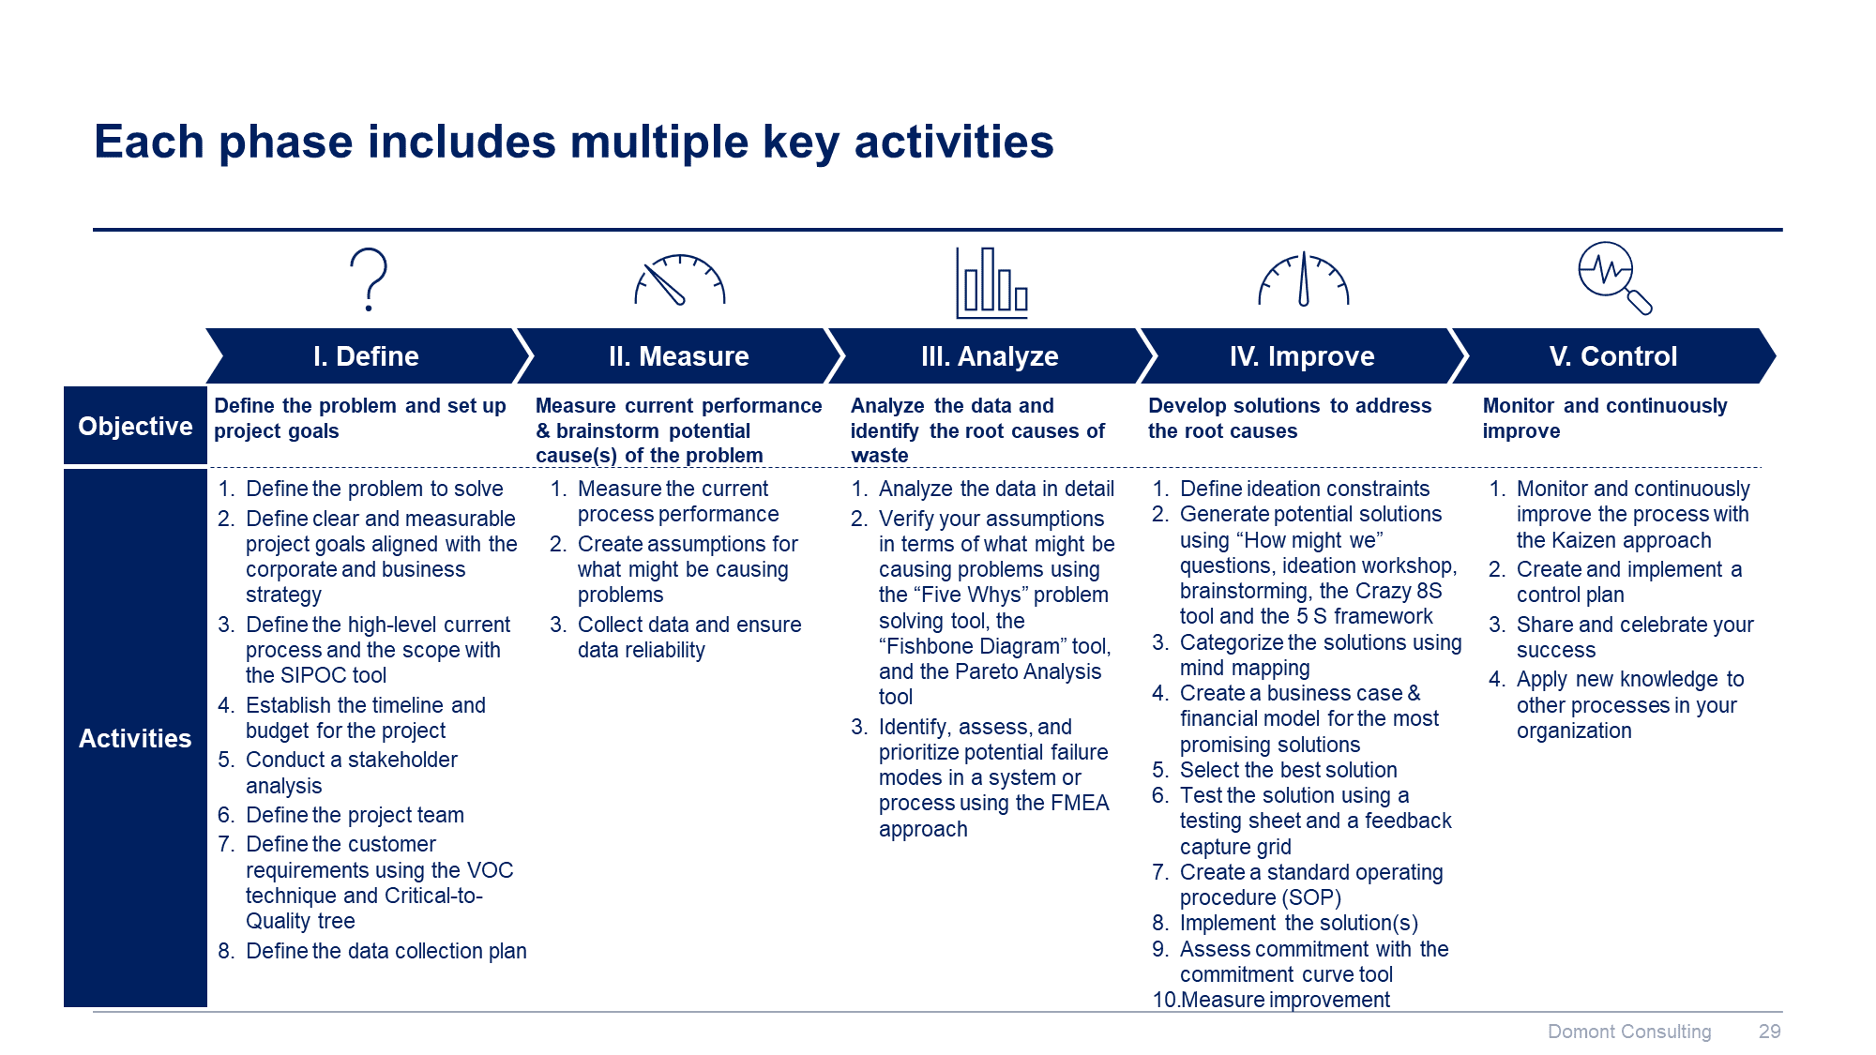
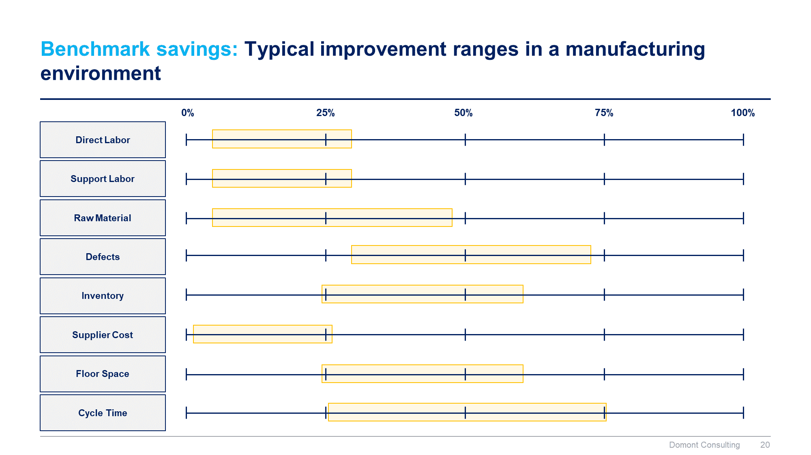
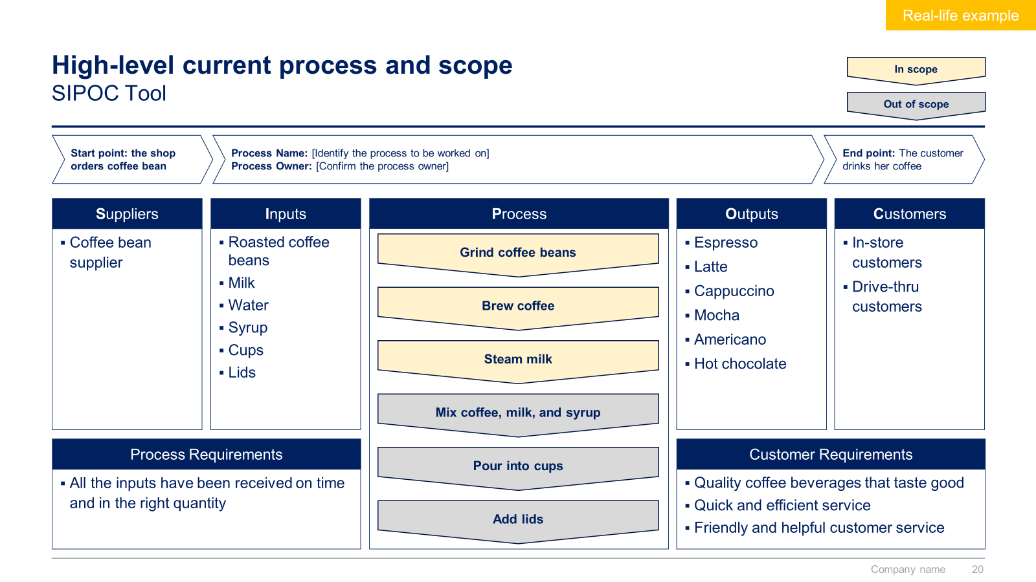
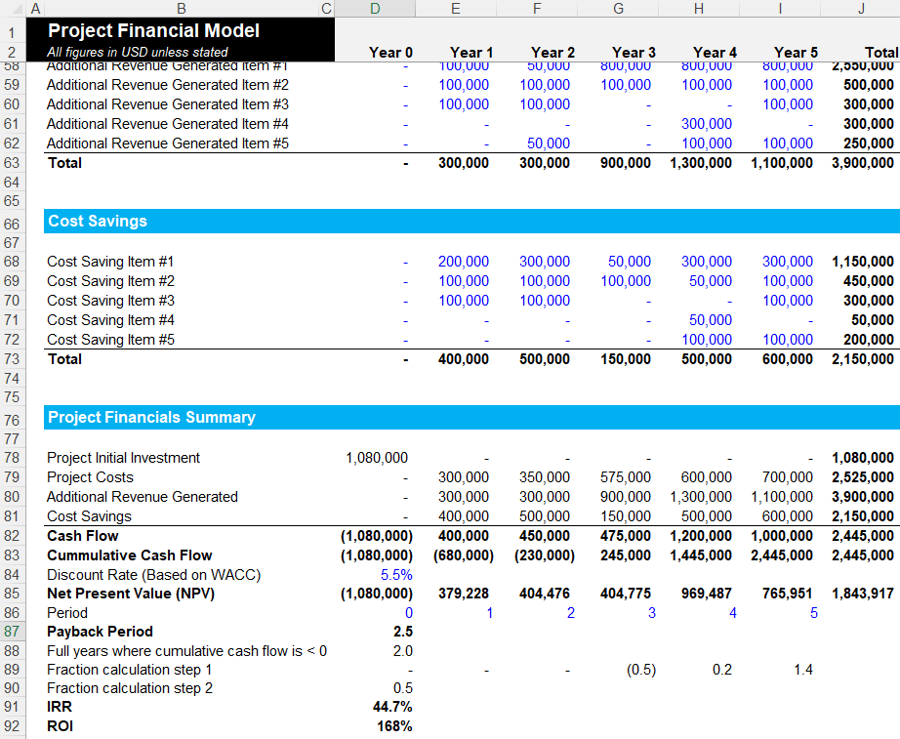
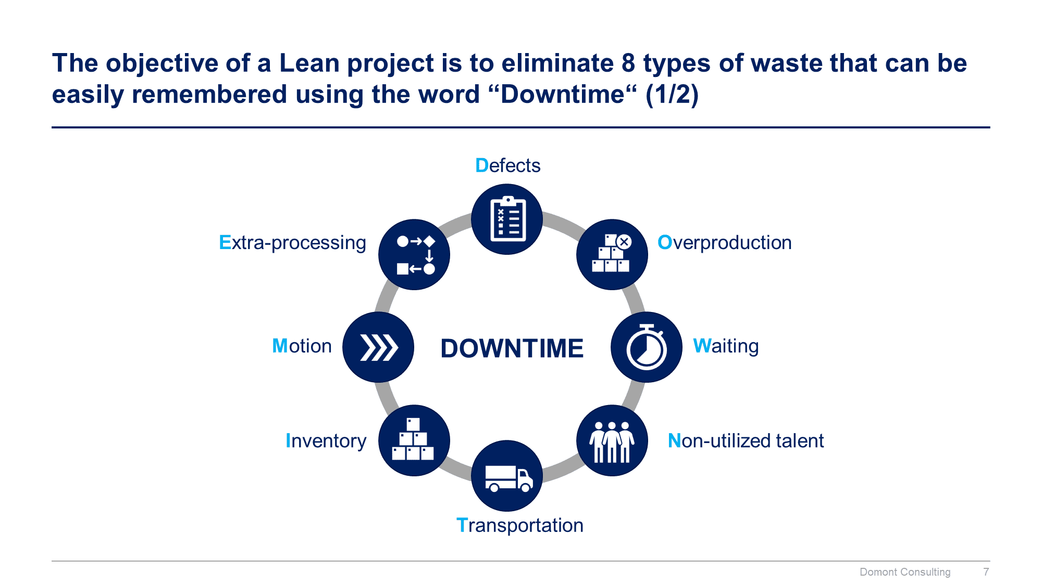
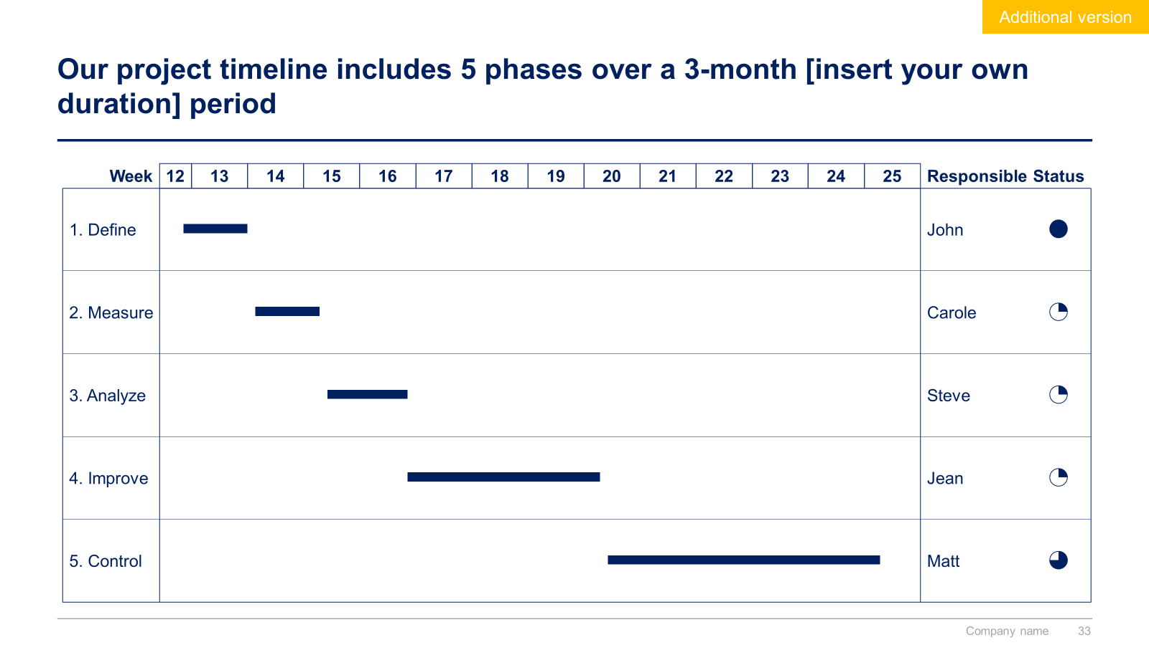
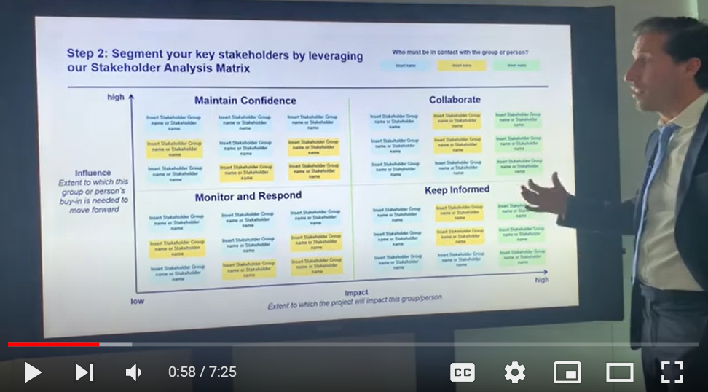
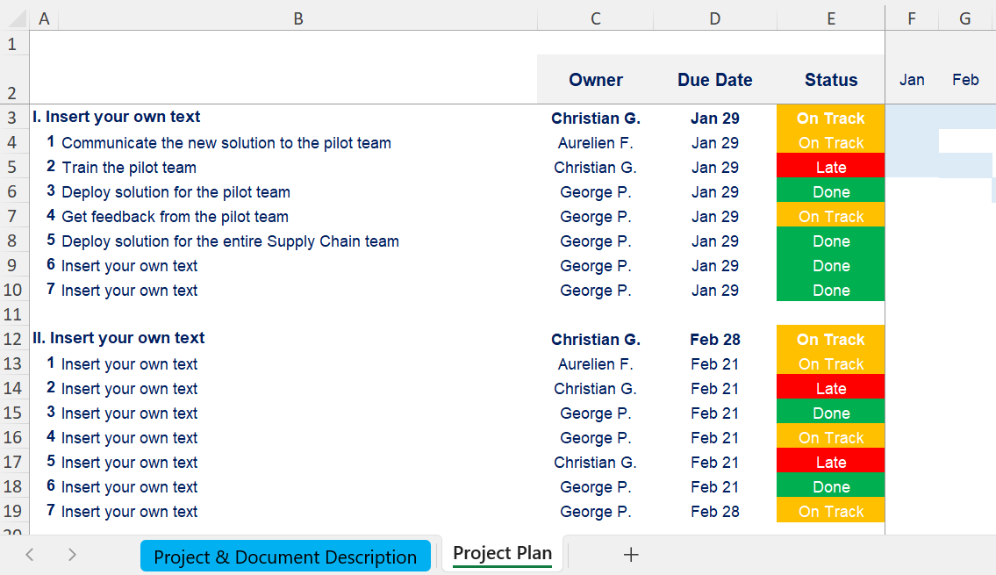

Slide 3


Introduction
This Toolkit was created by ex-McKinsey, Deloitte and BCG Management Consultants specialized in Lean Six Sigma. It includes all the Frameworks, Best Practices & Templates required to adopt and implement Lean 6 Sigma within your organization using the world-class DMAIC approach. Build success stories such as Motorola who saved over $16 billion in costs and increased customer satisfaction by 15% using Lean 6 Sigma.
Join the 200,000+ Executives, Consultants & Entrepreneurs who are already leveraging our Management Consulting Toolkits to improve the performance of their organization and boost their own career.
If you have any questions, send us an email at support@domontconsulting.com and one of our ex-McKinsey, Deloitte & BCG Management Consultants will get back to you within 2 business days.
Aurelien Domont
Management Consultant
Domont Consulting Managing Director

Slide 4

Table of contents
1
What is Lean Six Sigma?
2
What are the key benefits of using Lean Six Sigma?
3
Lean Six Sigma Toolkit - Approach and overview

Slide 5
Table of contents
1
What is Lean Six Sigma?
2
What are the key benefits of using Lean Six Sigma?
3
Lean Six Sigma Toolkit - Approach and overview

Slide 6
Lean Six Sigma provides a balanced approach to simultaneously reducing complexity (Lean) and increasing reliability (Six Sigma)
Simple + Low reliability
Simple + High reliability
High
Simplicity
(Lean)
Complex + Low reliability
Complex + High reliability
Low
Low
High
Reliability
(Six Sigma)

Slide 7
Lean methodology focuses on simplifying processes
Lean is a structured approach focusing on simplifying processes by eliminating the tasks that don’t bring value to the end customer.
This approach was mostly derived from the Toyota Production System (TPS) in the beginning of the 20th century and identified as "lean" only in the 1990s

Slide 8








The objective of a Lean project is to eliminate 8 types of waste that can be easily remembered using the word “Downtime“ (1/2)
Defects
Extra-processing
Overproduction
Motion
DOWNTIME
Waiting
Inventory
Non-utilized talent
Transportation

Slide 9
The objective of a Lean project is to eliminate 8 types of waste that can be easily remembered using the word “Downtime“ (2/2)
Defects
Making mistakes that cause products to fail customer requirements
Transportation
Unnecessary movements of products and materials
Defects
Defects
Overproduction
Making more than it is immediately required
Inventory
Storing parts, pieces, documentation ahead of requirements
Defects
Defects
Waiting
Waiting for the previous step in the process to complete
Motion
Unnecessary movements by people
Defects
Defects
Non-utilized talent
Not recognizing and utilizing human talent and creativity available within the workforce
Extra-processing
Performing any activity that is not necessary to produce a functioning product or service
Defects
Defects

Slide 10
The objective of a Lean project is to eliminate 8 types of waste that can be easily remembered using the word “Downtime“ (2/2)
Real-life example
Defects
Wrong-site surgeries
Medication errors
Dealing with service complaints
Illegible, handwritten information
Collection of incorrect patient information
Transportation
Moving patients from room to room
Poor workplace layouts, for patient services
Moving equipment in and out of procedure room or operating room
Defects
Defects
Overproduction
Multiple signature requirements
Extra copies of forms
Multiple information systems entries
Printing hard copy of report when digital is sufficient
Inventory
Overstocked medications on units/floors or in pharmacy
Physician orders building up to be entered
Unnecessary instruments contained in operating kits
Defects
Defects
Waiting
Early admissions for procedures later in the day
Waiting for internal transport between departments
Motion
Leaving patient rooms to get supplies or record
Large reach/walk distance to complete a process step
Defects
Defects
Non-utilized talent
Not using people’s mental, creative, and physical abilities
Staff not involved in redesigning processes in their workplace
Extra-processing
Asking the patient the same questions multiple times
Unnecessary carbon copying
Batch printing patient labels
Defects
Defects

Slide 11
Six Sigma methodology focuses on improving process reliability
Six Sigma is a structured approach focusing on improving process reliability in order to eliminate the defects in products and services.
This approach was developed in 1986 by Motorola and popularized by GE.

Slide 12
The objective of a Six Sigma project is to reduce process variation to such a degree that the sigma’s of variation will fit within the specification limits
Customer lower specification limit (LSL)
Customer higher specification limit (HSL)
Reduce Variations
Defects
Defects
4s
3s
2s
1s
1s
2s
3s
4s
Technically, 6s refers to having a process that will result in fewer than 3.4 defects per one million opportunities (DPMO)

Slide 13
Lean Six Sigma focuses on simplifying processes and improving process reliability
Lean
Six Sigma
Lean Six Sigma
A structured approach focusing on simplifying processes
A structured approach focusing on improving process reliability in order to eliminate the defects in products and services
A performance improvement methodology focusing on simplifying processes and improving process reliability
+
=

Slide 14
Lean Six Sigma key principles
Focus on your customer
Defining the customer’s perception of value is key to improving the process
Measure process performance
The process performance needs to be measured before and after implementing Lean Six Sigma
Identify value stream
Your value stream is “the processes of creating, producing, and delivering a good or service to the market”¹
Source: APICS Dictionary

Slide 15



Lean 6 Sigma background
1950’s – 70’s
1980’s
1990’s
2000’s
Business Improvement Tools/Methods
1950s: W. Edward Deming Plan-Do-Check-Act
1960s/70s: Toyota Lean Production System
1980s: - Motorola initiates ”Six Sigma Quality” - TQM - Malcom Baldridge Award
1990s: Lean manufacturing application to non-automotive industries begins
2000: Lean Six Sigma adoption increases
Industries
Primarily Automotive and Heavy Equipment
Expansion across Automotive and Manufacturing
Beginning of use in Pharmaceutical and Financial Services
Automotive
Consumer Business
Pharmaceutical
Healthcare
Financial Services
Companies
Japanese car makers
Motorola
GE
Johnson & Johnson
Citigroup
Allied Signal
Campbells
Coors
Merrill Lynch
JP Morgan
Cargill
Caterpillar

Slide 16
Table of contents
1
What is Lean Six Sigma?
2
What are the key benefits of using Lean Six Sigma?
3
Lean Six Sigma Toolkit - Approach and overview

Slide 17
Lean Six Sigma addresses both tactical and strategic value drivers linked directly to shareholder value
Shareholder Value
Revenue Growth
Operating Margin
Asset Efficiency
On-time delivery
Lead time/Cycle time reduction
Improved product quality
Reduced time to market
Reduced supply chain costs
Reduced factory operating expenses
Reduced SG&A costs
Reduced quality costs
Reduced IT costs
Inventory reduction
Improved labor productivity
Asset consolidation
Increased factory space
Greater return on IT investment

Slide 18
Lean Six Sigma benefit #1: Lean Six Sigma increases asset efficiency
Real-life example
Before
implementing Lean Six Sigma
After
implementing Lean Six Sigma
One employee was able to process 2 home loans a day
One employee was able to process 4 home loans a day
=
=
Other examples: Implementing Lean Six Sigma can also help decrease your stock and optimize your working space

Slide 19
Lean Six Sigma benefit #2: Lean Six Sigma decreases cost
Real-life example
Before
implementing Lean Six Sigma
After
implementing Lean Six Sigma
Number of broken products and related cost to remanufacture them (per month):
Number of broken products and related cost to remanufacture them (per month):
Broken products
Cost
Broken products
Cost
8
$80k
1
$10k
Other examples: Implementing Lean Six Sigma can also help decrease your IT, supply Chain and SG&A costs
19

Slide 20
Lean Six Sigma benefit #3: Lean Six Sigma increases revenue
Real-life example
Before
implementing Lean Six Sigma
After
implementing Lean Six Sigma
A sales representative was focusing 20% of his time on administrative tasks and 80% of his time on selling products
The process improvement allowed the sales representative to focus only 10% of his time on administrative tasks and 90% of his time on selling products
Other examples: Implementing Lean Six Sigma can also help to improve product quality, on-time delivery and customer satisfaction

Slide 21
Benchmark savings: Typical improvement ranges in a manufacturing environment
0%
25%
50%
75%
100%
Direct Labor
Support Labor
Raw Material
Defects
Inventory
Supplier Cost
Floor Space
Cycle Time

Slide 22
Benchmark savings: Typical improvement ranges in a white-collar environment
0%
25%
50%
75%
100%
Labor
Supplies
Defects/Poor Quality
Value-add per employee
Cycle Time
Revenue Growth
Information Handoffs

Slide 23

Success stories of companies using Lean Six Sigma Motorola estimated that its Six Sigma program had saved the company over $16 billion in costs and increased customer satisfaction by 15%
Motorola is a global telecommunications company that is often credited with the development of the Six Sigma methodology. In the 1980s, Motorola was struggling with quality control issues in its manufacturing processes, which led to high costs and low customer satisfaction. To address these issues, Motorola implemented the Six Sigma methodology to improve its processes and reduce defects.
As a result of its Six Sigma efforts, Motorola was able to significantly reduce defects in its products, which led to increased customer satisfaction and reduced costs. In fact, by the early 1990s, Motorola estimated that its Six Sigma program had saved the company over $16 billion in costs and increased customer satisfaction by 15%.
Motorola's success with Six Sigma has inspired many other companies to adopt the methodology and has helped to establish Six Sigma as a leading approach to process improvement. Today, Six Sigma is used by companies around the world to improve their processes and increase efficiency.

Slide 24

Success stories of companies using Lean Six Sigma Toyota is widely regarded as one of the most efficient and effective automotive manufacturers in the world
Toyota is a Japanese automotive manufacturer that is known for its use of Lean manufacturing principles. In the early 2000s, Toyota was struggling with quality control issues in its manufacturing processes, which led to a series of high-profile recalls and damaged the company's reputation.
To address these issues, Toyota implemented a Six Sigma program to improve its processes and reduce defects. The company also introduced a quality control initiative called "Total Quality Management" (TQM) that emphasized the importance of continuous improvement and employee involvement.
As a result of its Six Sigma and TQM efforts, Toyota was able to significantly improve its product quality and reduce defects. In fact, the company's quality control improvements were so successful that they became known as the "Toyota Way" and have been emulated by many other companies around the world.
Today, Toyota is known for its commitment to quality and continuous improvement, and is widely regarded as one of the most efficient and effective automotive manufacturers in the world.

Slide 25

Success stories of companies using Lean Six Sigma GE has credited Lean Six Sigma with saving the company billions of dollars and improving customer satisfaction
General Electric (GE) is a multinational conglomerate that has been using Lean Six Sigma since the 1990s to improve its manufacturing and business processes. GE has credited Lean Six Sigma with saving the company billions of dollars and improving customer satisfaction.
One of the most famous success stories from GE's Six Sigma program is its efforts to improve the quality of its aircraft engines. In the 1990s, GE's aircraft engines were experiencing high levels of defects and failures, which were leading to costly repairs and replacements.
To address these issues, GE implemented the Six Sigma methodology to improve its manufacturing processes and reduce defects. The company also introduced a quality control initiative called "Design for Six Sigma" (DFSS) that emphasized the importance of designing products that were less likely to fail.
As a result of its Six Sigma and DFSS efforts, GE was able to significantly improve the quality of its aircraft engines and reduce the number of defects and failures. In fact, by the early 2000s, GE's aircraft engines had become so reliable that they were considered the most reliable engines in the world.

Slide 26
Table of contents
1
What is Lean Six Sigma?
2
What are the key benefits of using Lean Six Sigma?
3
Lean Six Sigma Toolkit - Approach and overview

Slide 27












Our ex-McKinsey, Deloitte & BCG consultants created a Lean 6 Sigma Toolkit to help you achieve your organization’s strategic objectives
What’s inside the Toolkit?
Who created the Toolkit?
The Toolkit was created by former McKinsey, Deloitte & BCG management consultants.
Best Practices
Frameworks
Number of professionals leveraging our Toolkits
Advice from
tier-1 Management Consultants
Tools
There are 200,000+ Executives, Consultants & Entrepreneurs leveraging our Toolkits to improve the performance of their organization.
Real-life Examples
Templates
Trusted by small and large organizations
Video Training
Step-by-step Tutorials

Slide 28
Our Toolkit will help you fulfill multiple objectives
The Lean 6 Sigma Toolkit includes frameworks, tools, templates, tutorials, real-life examples, video training, and best practices to help you:
Adopt and implement a Lean 6 Sigma methodology within your organization using the 5 phases of the world-class DMAIC approach: (I) Define, (II) Measure, (III) Analyze, (IV) Improve, (V) Control
(I) Define: (1) Define the problem to solve, (2) Define clear and measurable project goals aligned with the corporate and business strategy, (3) Define the high-level current process and the scope with the SIPOC tool, (4) Establish the timeline and budget for the project, (5) Conduct a stakeholder analysis, (6) Define the project team, (7) Define the customer requirements using the VOC technique and Critical-to-Quality tree, (8) Review and select data analytics tools and techniques, (9) Define the data collection plan
(II) Measure: (1) Measure the current process performance, (2) Create assumptions for what might be causing problems, (3) Collect data and ensure data reliability
(III) Analyze: (1) Analyze the data in detail, (2) Verify your assumptions in terms of what might be causing problems using the “Five Whys” problem solving tool, the “Fishbone Diagram” tool, and the Pareto Analysis tool, (3) Identify, assess, and prioritize potential failure modes in a system or process using the FMEA approach
(IV) Improve: (1) Define ideation constraints, (2) Generate potential solutions using “How might we” questions, ideation workshop, brainstorming, the Crazy 8S tool and the 5 S framework, (3) Categorize the solutions using mind mapping, (4) Create a business case & financial model for the most promising solutions, (5) Select the best solution, (6) Test the solution using a testing sheet and a feedback capture grid, (7) Create a standard operating procedure (SOP), (8) Implement the solution(s), (9) Assess commitment with the commitment curve tool, (10) Measure improvement
(V) Control: (1) Monitor and continuously improve the process with the Kaizen approach, (2) Create and implement a control plan, (3) Share and celebrate your success, (4) Apply new knowledge to other processes in your organization
Build success stories such as Motorola who saved over $16 billion in costs and increased customer satisfaction by 15% by applying Lean 6 Sigma

Slide 29

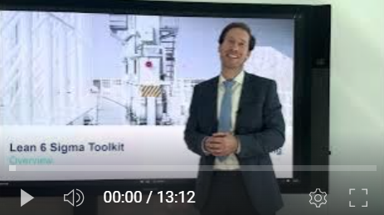
Video demonstration of the Toolkit
Video Demo Access
Video Demo Visual
Select “Slide Show” mode and then click on the link below or on the image on the right to access this video demo.
You can also access the video by copy pasting the following URL in your browser:
https://youtu.be/HV5ewjpjF0Q

Slide 30





The Lean 6 Sigma DMAIC methodology is an iterative process which includes 5 phases
I. Define
II. Measure
III. Analyze
IV. Improve
V. Control

Slide 31
Each phase includes multiple key activities
I. Define
II. Measure
III. Analyze
IV. Improve
V. Control
Objective
Define the problem and set up project goals
Measure current performance & brainstorm potential cause(s) of the problem
Analyze the data and identify the root causes of waste
Develop solutions to address the root causes
Monitor and continuously improve
Activities
Define the problem to solve
Define clear and measurable project goals aligned with the corporate and business strategy
Define the high-level current process and the scope with the SIPOC tool
Establish the timeline and budget for the project
Conduct a stakeholder analysis
Define the project team
Define the customer requirements using the VOC technique and Critical-to-Quality tree
Review and select data analytics tools and techniques
Define the data collection plan
Measure the current process performance
Create assumptions for what might be causing problems
Collect data and ensure data reliability
Analyze the data in detail
Verify your assumptions in terms of what might be causing problems using the “Five Whys” problem solving tool, the “Fishbone Diagram” tool, and the Pareto Analysis tool
Identify, assess, and prioritize potential failure modes in a system or process using the FMEA approach
Define ideation constraints
Generate potential solutions using “How might we” questions, ideation workshop, brainstorming, the Crazy 8S tool and the 5 S framework
Categorize the solutions using mind mapping
Create a business case & financial model for the most promising solutions
Select the best solution
Test the solution using a testing sheet and a feedback capture grid
Create a standard operating procedure (SOP)
Implement the solution(s)
Assess commitment with the commitment curve tool
Measure improvement
Monitor and continuously improve the process with the Kaizen approach
Create and implement a control plan
Share and celebrate your success
Apply new knowledge to other processes in your organization

Slide 32
Small preview of the Phase I
I. Define
II. Measure
III. Analyze
IV. Improve
V. Control

Slide 33
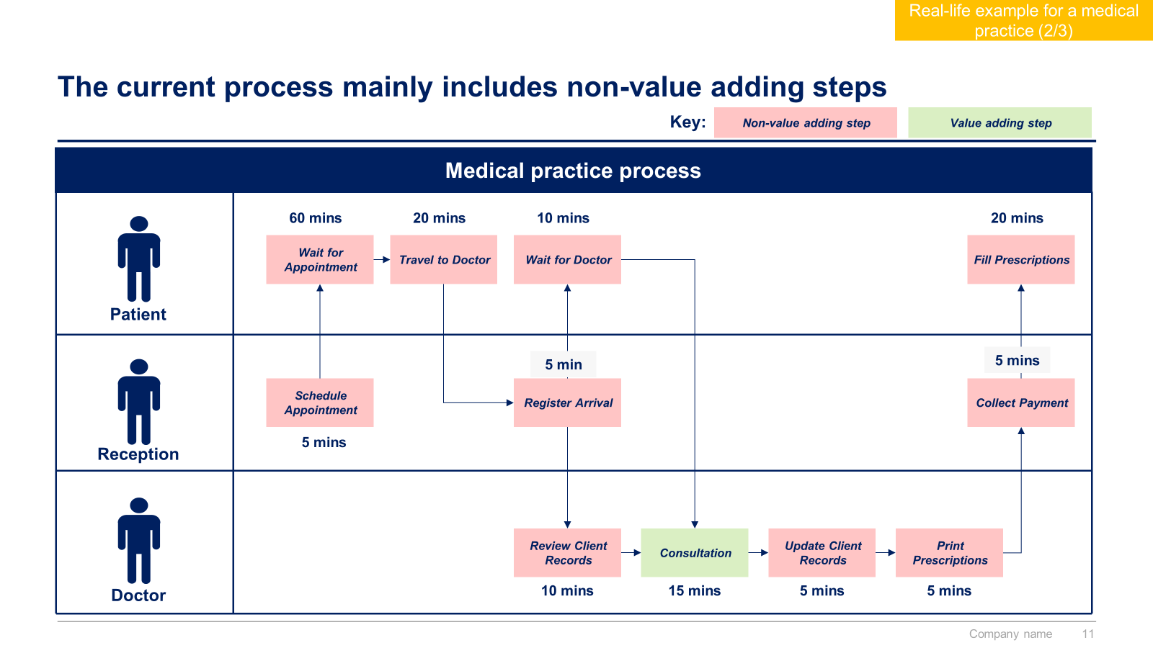
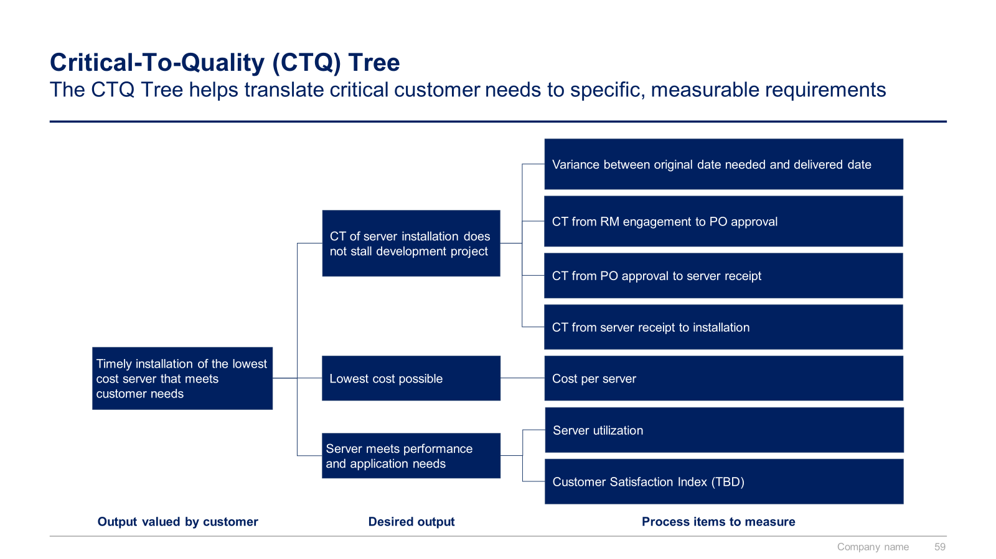
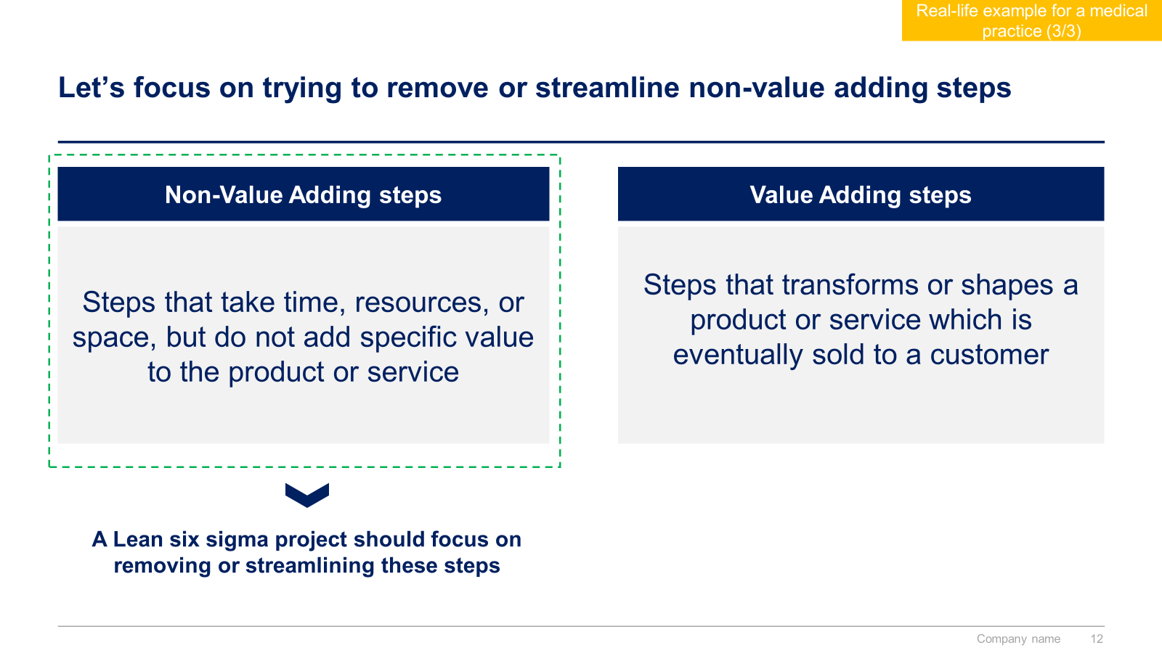
Small preview of the Phase II
I. Define
II. Measure
III. Analyze
IV. Improve
V. Control

Slide 34
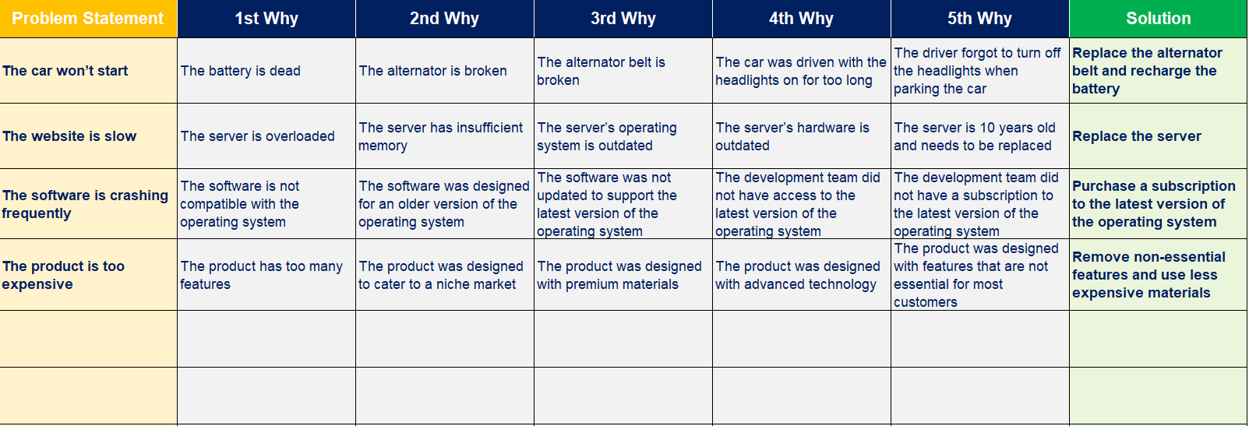
Small preview of the Phase III
I. Define
II. Measure
III. Analyze
IV. Improve
V. Control

Slide 35
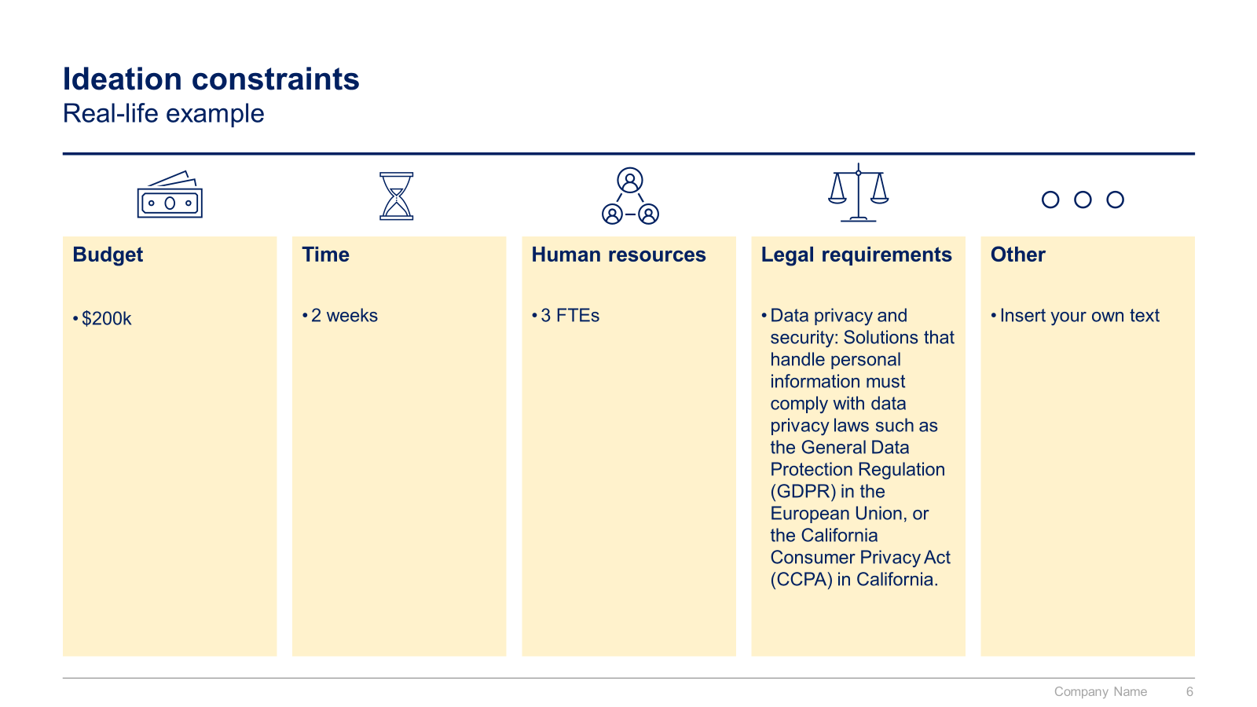
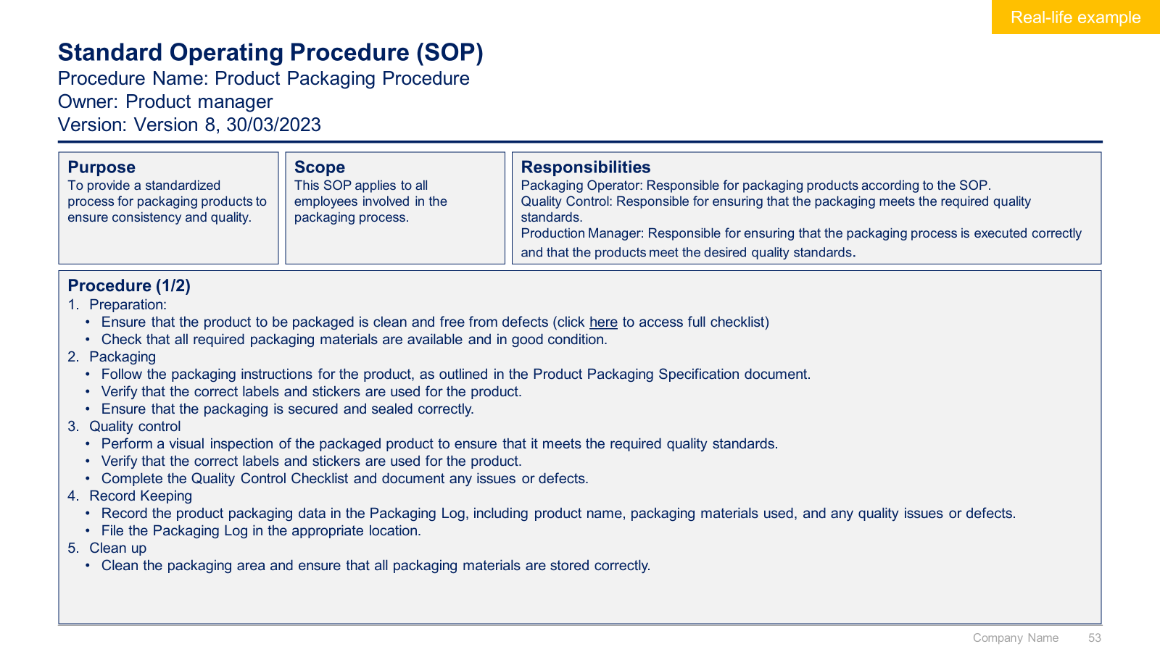
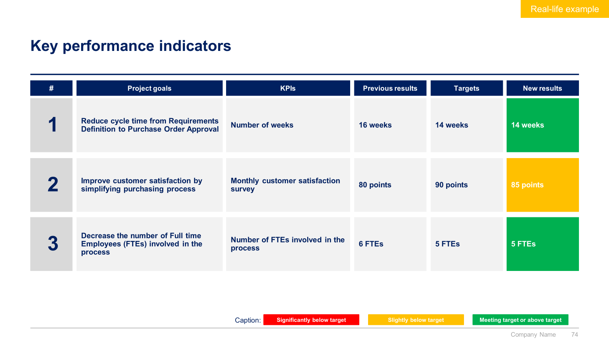
Small preview of the Phase IV (1/2)
I. Define
II. Measure
III. Analyze
IV. Improve
V. Control

Slide 36
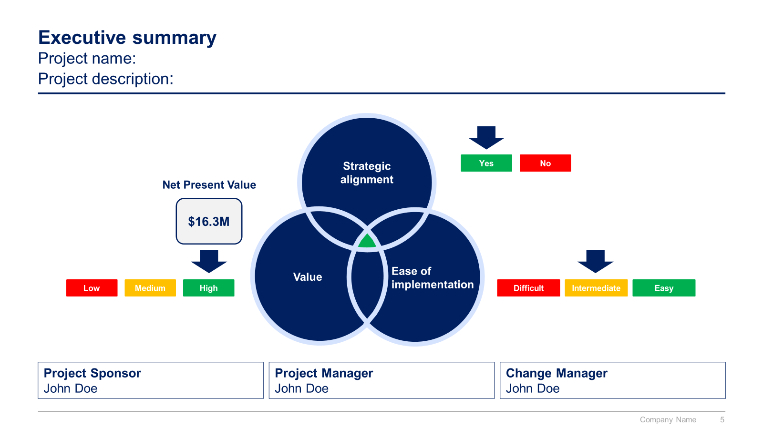
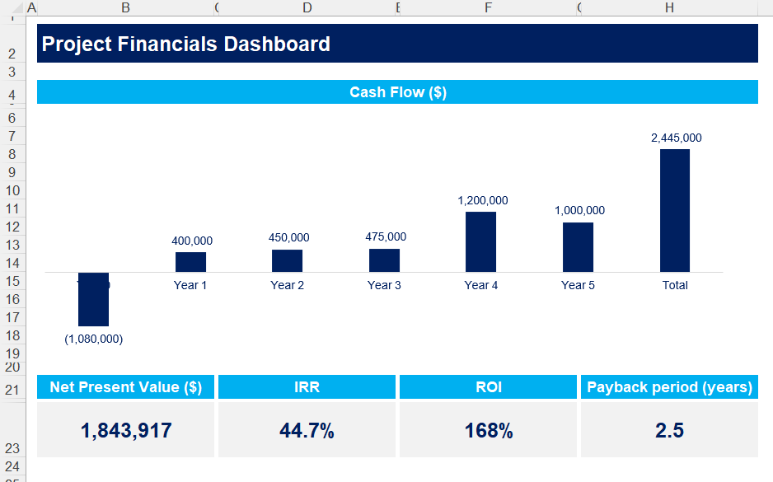
Small preview of the Phase IV (2/2)
I. Define
II. Measure
III. Analyze
IV. Improve
V. Control

Slide 37
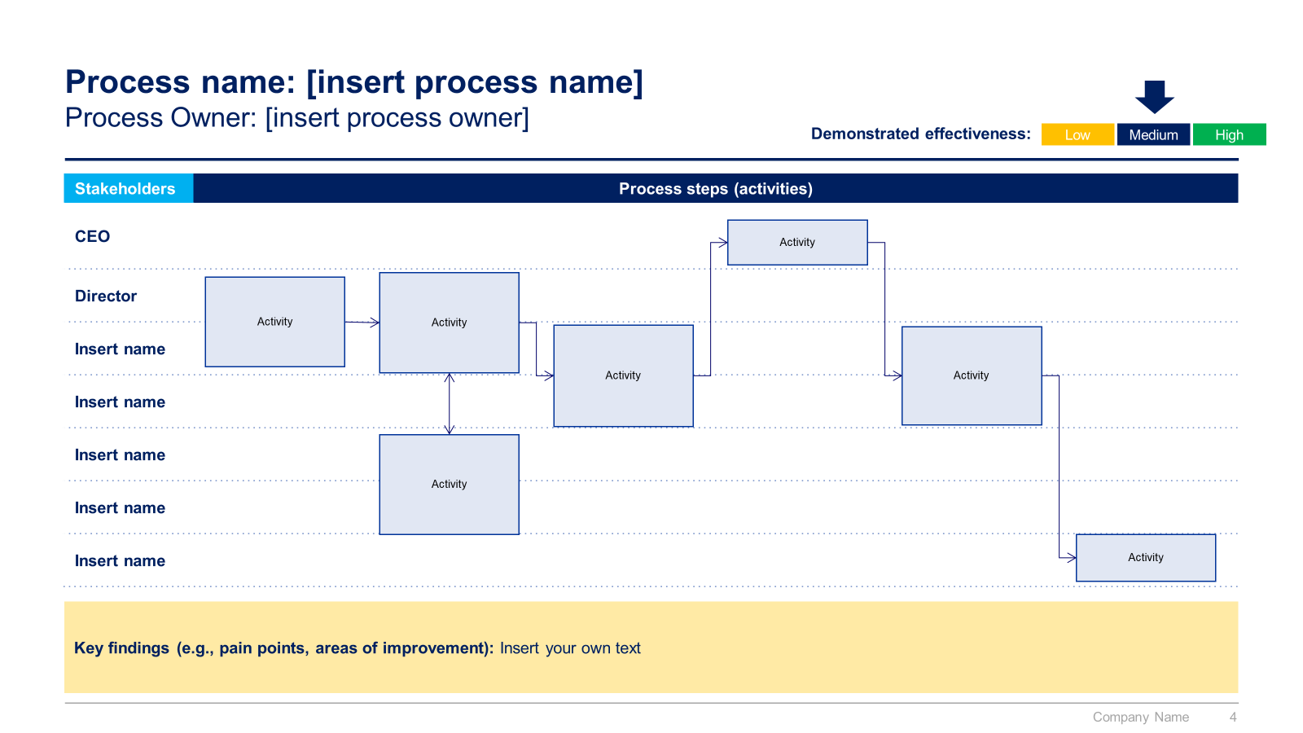
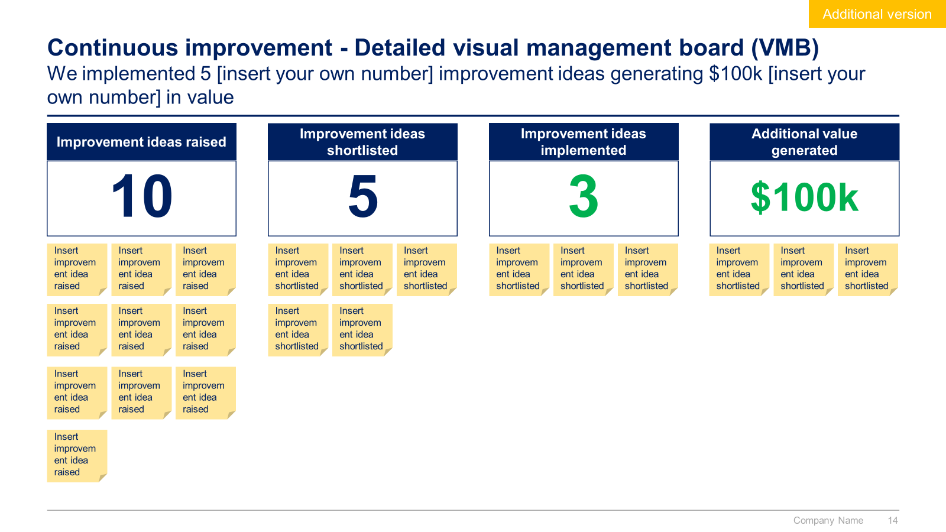
Small preview of the Phase V
I. Define
II. Measure
III. Analyze
IV. Improve
V. Control

Slide 38



The Toolkit includes multiple PowerPoint slides, Excel sheets and Video training that you can download on your device immediately after purchase
330 editable PowerPoint slides*
21 Excel sheets*
60 minutes of Video training
Overview and Approach
Define
Measure
Analyze
Improve
Control
*Please note that the number of Powerpoint slides and Excel sheets listed is the number of unique slides and sheets. For example, a Powerpoint slide that has been duplicated to facilitate our clients’ understanding only counts for one slide

Slide 39









Our Management Consulting Toolkits include 9 key benefits
Improve the growth & efficiency of your organization by leveraging Management Consulting Toolkits created by ex-McKinsey, Deloitte & BCG Consultants.
Make a great investment for your career & organization. It cost us US$8M+ over the past 10 years to create all our Toolkits. Get them for a fraction of this cost.
Get a competitive advantage. It’s like hiring Management Consultants to create all the practical Frameworks, Tools & Templates you need.
Get the job done quicker and never start from scratch again with our ready-made and fully editable Frameworks, Tools & Templates in Powerpoint & Excel.
Don't reinvent the wheel. We have already worked 30,000+ hours over the past 10 years to create all the Management Consulting Toolkits you need.
Improve the capabilities of your organization by learning how the Fortune 100 and Global Consulting Firms do it.
Decrease your costs. Hiring tier-1 Consultants for a project would cost you $300k+. Way more expensive than our Toolkits, which will last you a lifetime!
Become your organization’s subject matter expert and impress your stakeholders with world-class approaches to resolve common business problems.
Get free support and advice from our ex-McKinsey, Deloitte & BCG Management Consultants.

Slide 40
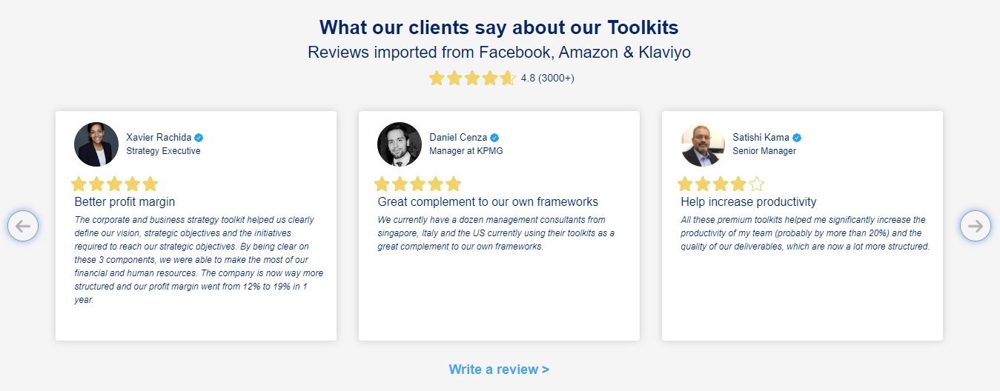
What our clients say about our Toolkits
Click here to see more reviews >

Slide 41

Join 200,000+ Executives, Consultants & Entrepreneurs leveraging our Toolkits to improve the performance of their organization
Trusted by small and large organizations
Customer satisfaction
4.8
Number of countries leveraging our Toolkits
160+
Number of professionals leveraging our Toolkits
200,000+
Daily rate of our ex-McKinsey, Deloitte and BCG Management Consultants
$3k-$4k

Slide 42

Interested in more than 1 Toolkit? Access all our Toolkits for half the price with our Gold Access
Gold Access
Click here to learn more

Slide 43






Need additional help? Send us a brief and we’ll find you the right talent from our network of 500+ tier-1 Management Consultants
Click here to send us a Project Brief

Slide 44

This was just a small preview.
www.domontconsulting.com

